Slide 1
Open Source Platform and Network Administration
Lesson 9

Slide 3
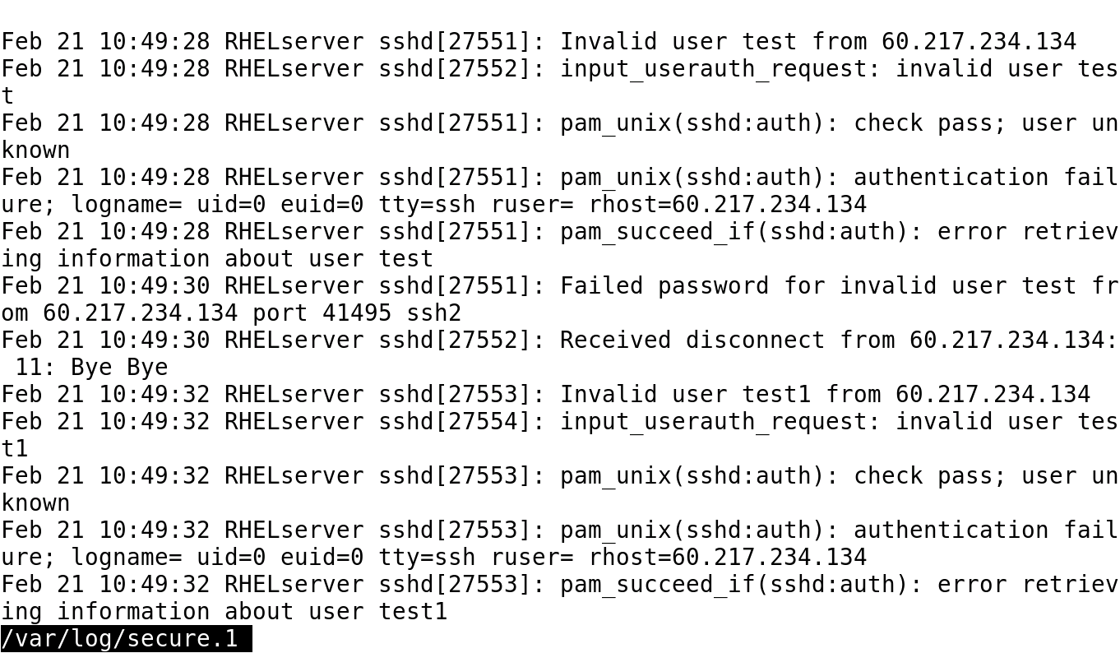
Failed Remote Login Attempts

Slide 4
Using PAM
An application can use its own authentication file in the /etc/pam.d directory.
PAM can be used to:
Allow access to specific application only during certain times of the day
Deny user logins based on files and restrict the user of the su command to only certain groups or users
Disconnect a user after ‘x’ number of login attempts

Slide 5
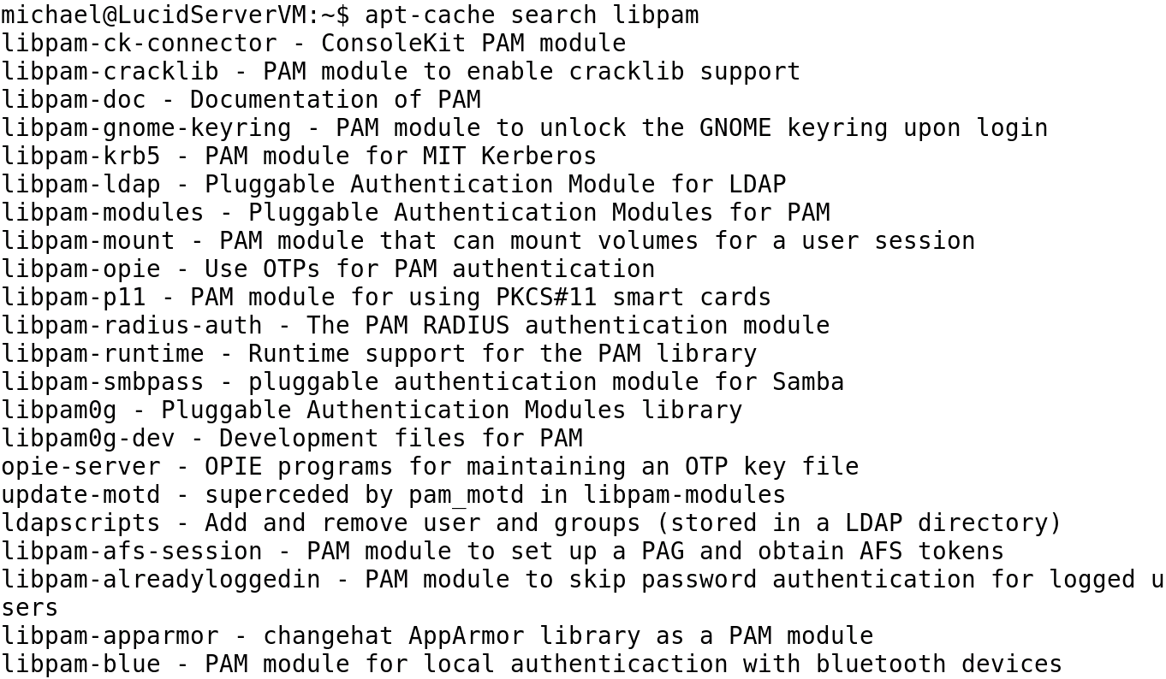
PAM-related Packages on Ubuntu

Slide 6
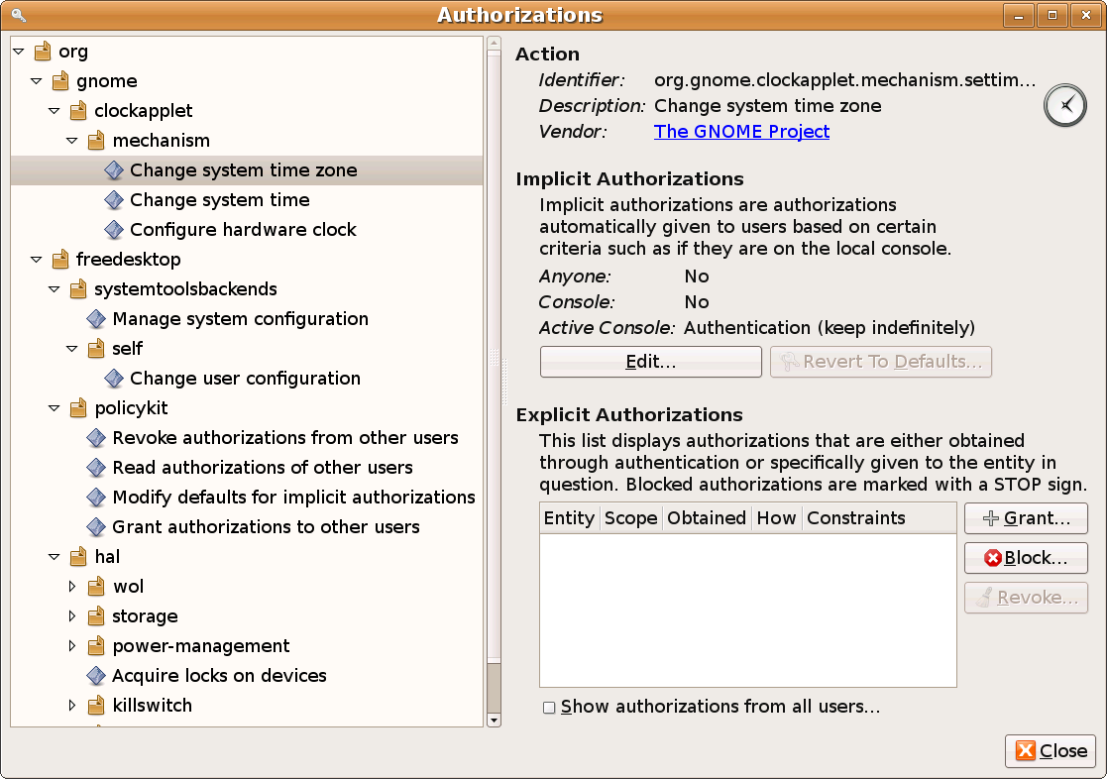
PolicyKit Authorizations Tool

Slide 7
Best Practices for Account Management
Create a password policy in /etc/login.defs file.
Lock user accounts that will not need access for a long period of time.
Set account expiration for temporary accounts.
Remove user and service accounts that are no longer being used.
Monitor account usage and login attempts.

Slide 8
Summary
System, service, and regular user accounts, group accounts, and user account policy
Best practices for account management
Process of establishing a user account policy, managing password change, and using sudo command
Files with ACL permissions and the roles and responsibilities of a Linux system administrator
Use of PAM

Slide 9
Virtual Lab
Hardening Security with User Account Management and Security Controls
Notes:
If your educational institution included the Jones & Bartlett labs as part of the course curriculum, use this script to introduce the lab:
"In this lesson, you reviewed how user and group security is handled in the Linux environment. You learned that every user and group has a unique ID number and that each user account is configurable with a variety of advanced privileges. You discovered that Linux has a hierarchy of administrative privileges and that the su command allows a user with the root password to temporarily take on an administrators privileges. You also were introduced to PAM for restricting user logins.
In this lab, you will harden user accounts on a Linux system with a secure password policy definition. This definition will include the use of user groups to better manage large numbers of users. You also will create temporary user accounts and apply automatic account and password deletion after 90 days."

Slide 10
OPTIONAL SLIDES

Slide 11
System, Service, and Regular User Accounts
System Account | Service Account | Regular Account
Created when the operating system is installed | Created automatically when installing a service using a package management program | Created by root or an account with privileged access
Users and groups < 100 | Users and groups < 500 | Users and groups > 500
Login directory typically set to /sbin/nologin or a system command, such as /sbin/shutdown | Login directory mostly set to /sbin/nologin but may also be set to a typical login shell, such as /bin/bash | Login directory set to /bin/bash

Slide 12
Establishing a User Account Policy
1. Open the /etc/login.defs file.
2. Set the Password Change directive.
3. Set the Warn directive.
4. Set the password minimum length.
5. Enable login failure logging.
8. Save and exit.
6. Enable successful login logging.
7. Enable the su command.
Notes:
Here are the commands used for this process:
Open the /etc/login.defs file.
Su –c ‘vi /etc/login.defs
Set the Password Change directive.
PASS_MAX_DAYS 60
Set the Warn directive.
PASS_WARN_AGE 14
Set the password minimum length.
PASS_MIN_LEN 8
Enable login failure logging.
FAILLOG_ENAB
Enable successful login logging.
LOG_OK_LOGINS
Enable the su command.
SYSLOG_SU_ENAB
Save and exit.

